Slide 1
vCloud Integration Workflows Supported Scenarios
Advanced Workflows version 1.0.0

Slide 2
Supported vCloud Operations
Create an Organization
Create an Organization VDC
Create an Isolated Org VDC Network
Create a vApp
Delete a vApp
Delete an Isolated Org VDC Network
Delete an Organization VDC
Delete an Organization

Slide 3
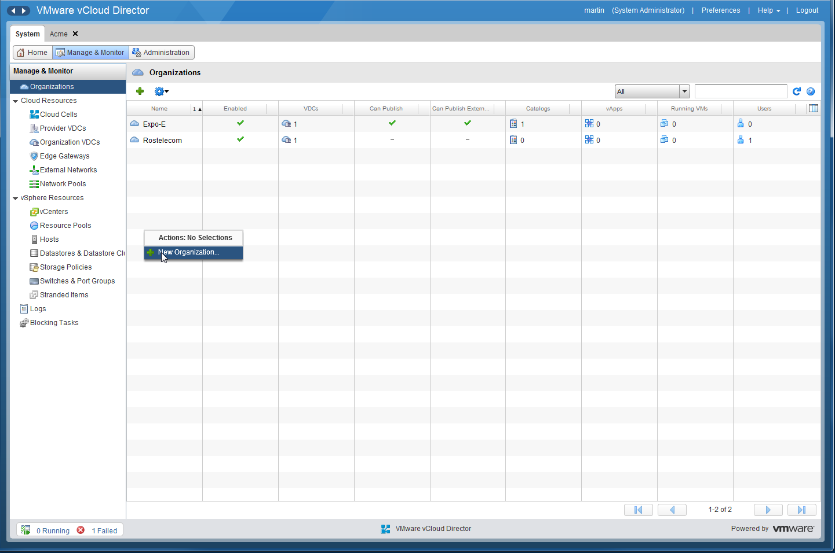
Create an Organization

Slide 4
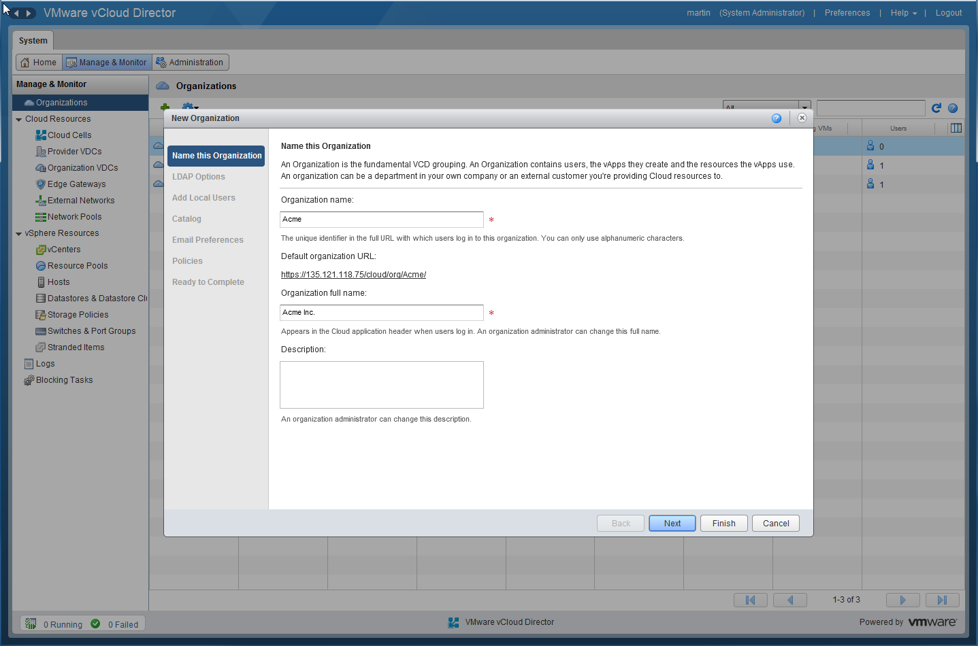
Create an Organization (Cont’d)

Slide 5
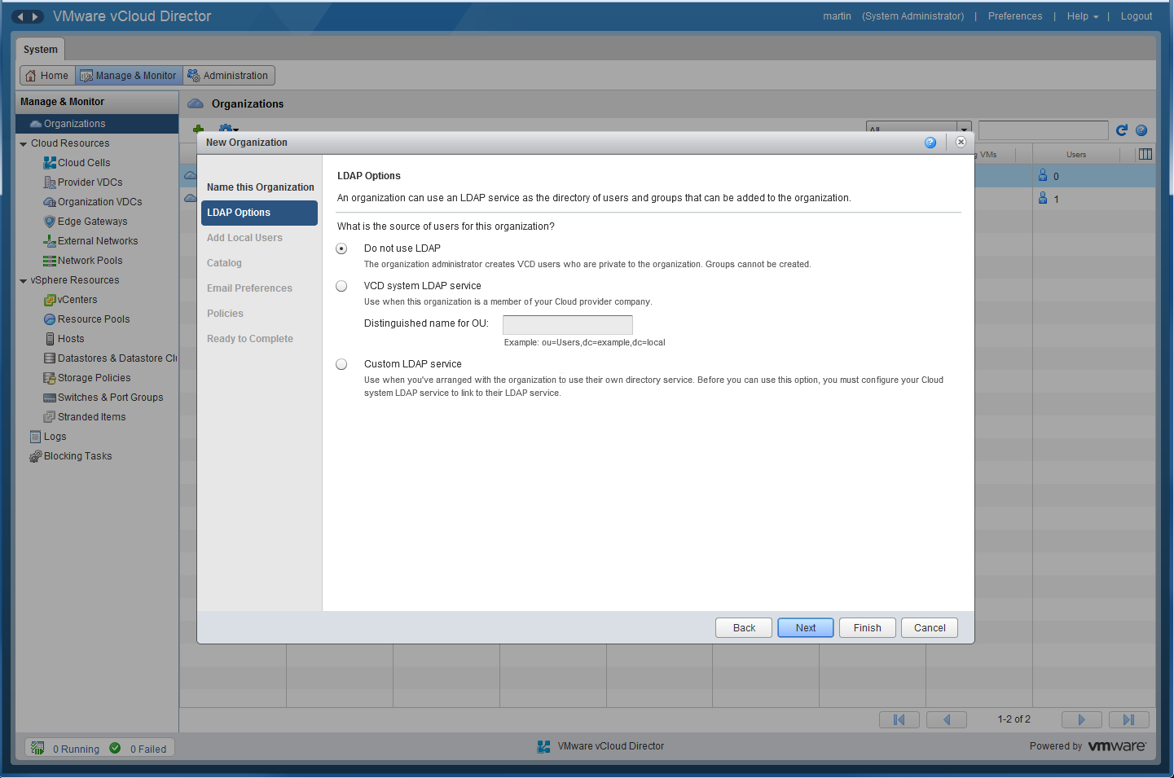
Create an Organization (Cont’d)

Slide 6
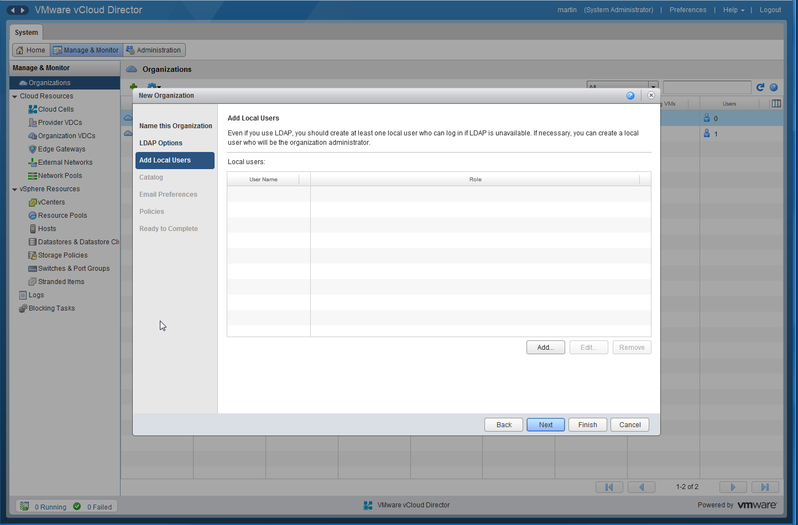
Create an Organization (Cont’d)

Slide 7
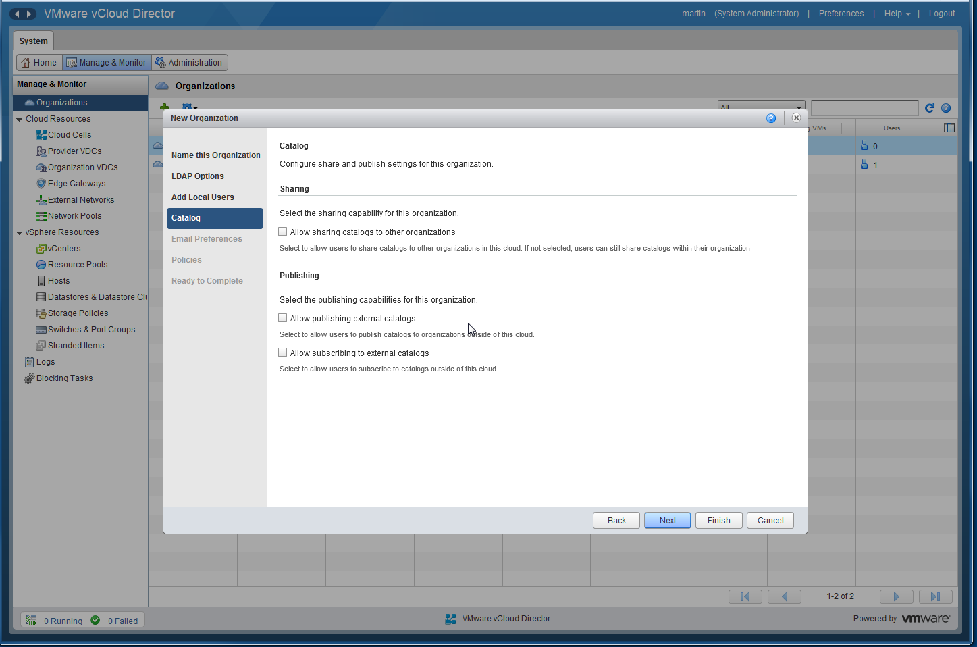
Create an Organization (Cont’d)

Slide 8
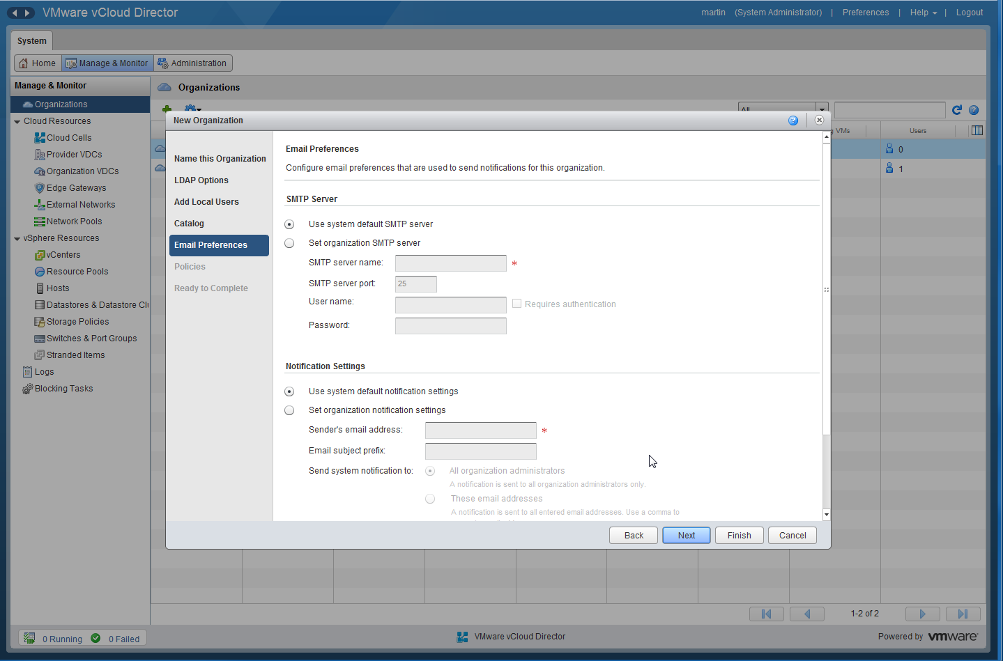
Create an Organization (Cont’d)

Slide 9
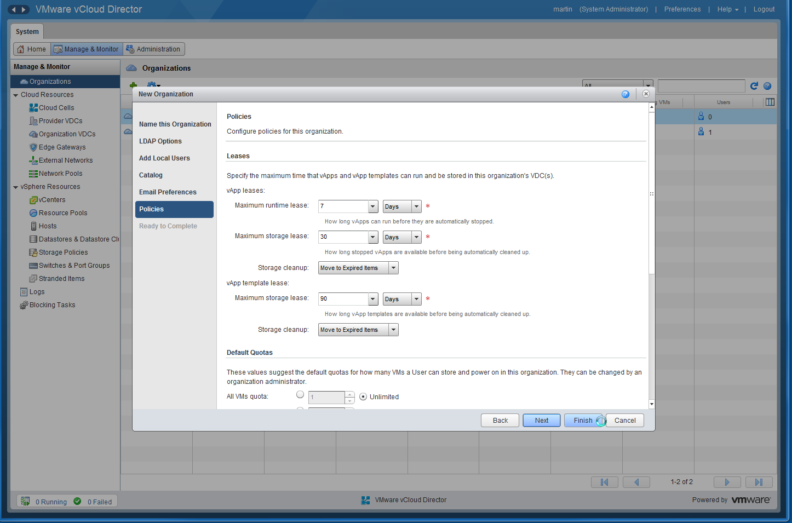
Create an Organization (Cont’d)

Slide 10
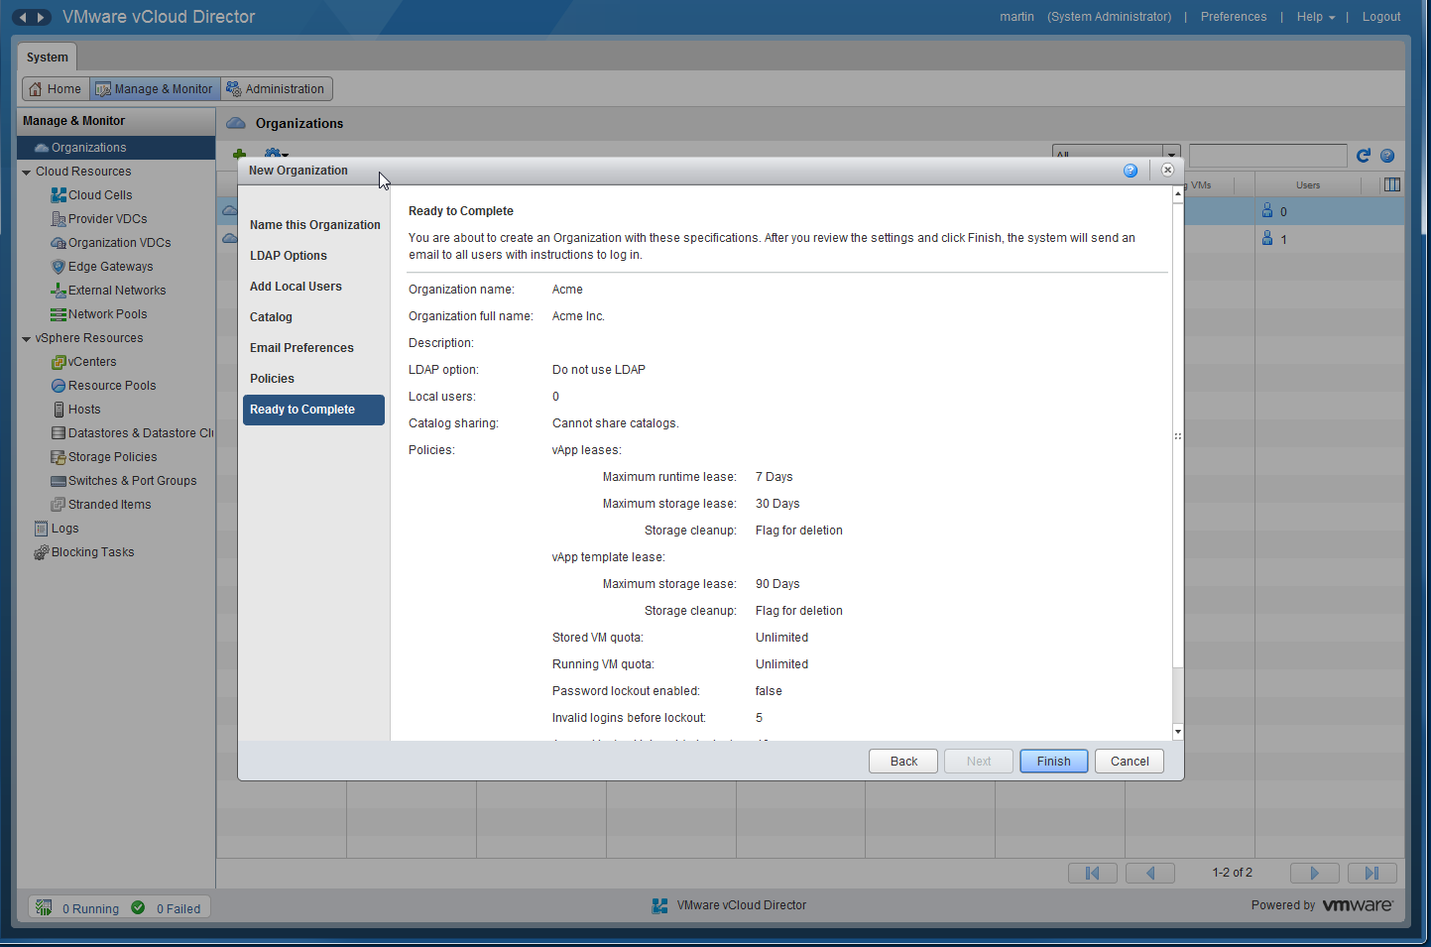
Create an Organization (Cont’d)

Slide 11
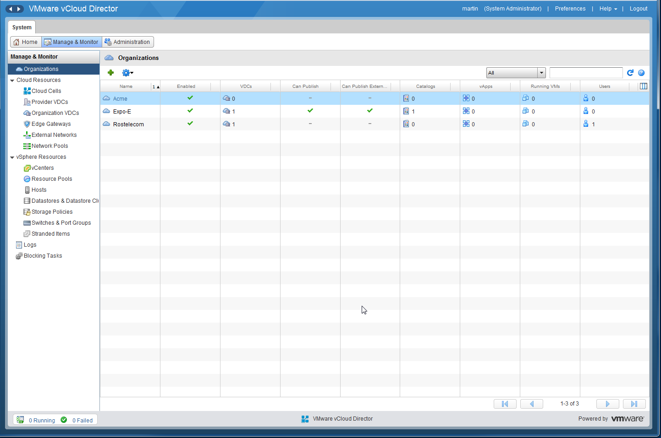
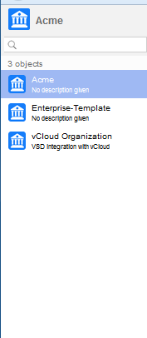
Create an Organization (Cont’d)

Slide 12
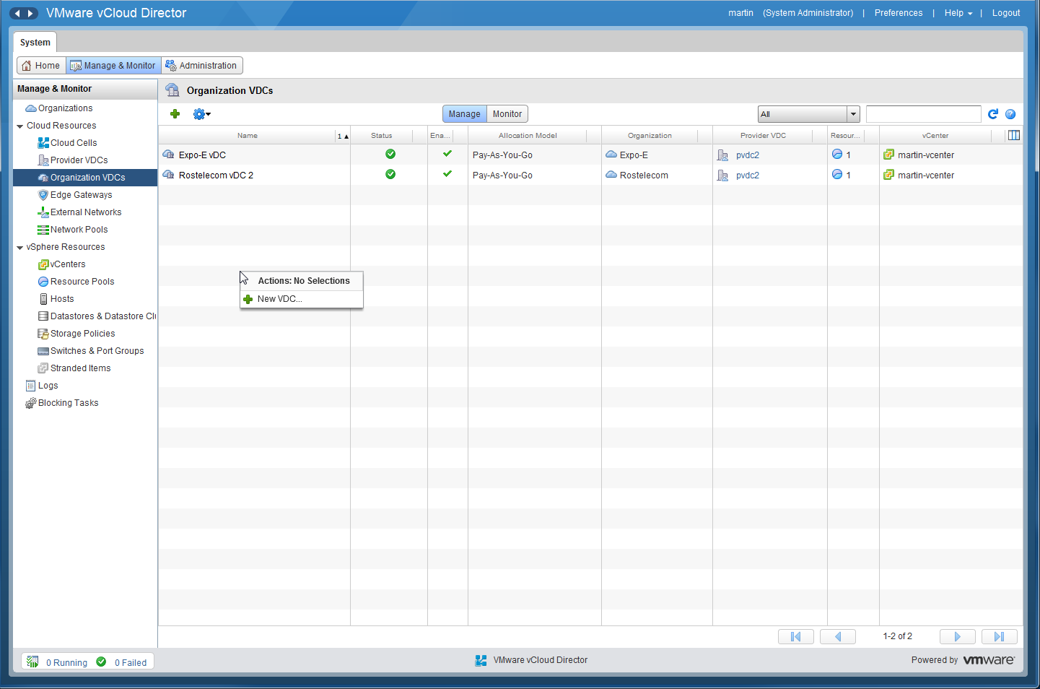
Create an Organization VDC

Slide 13
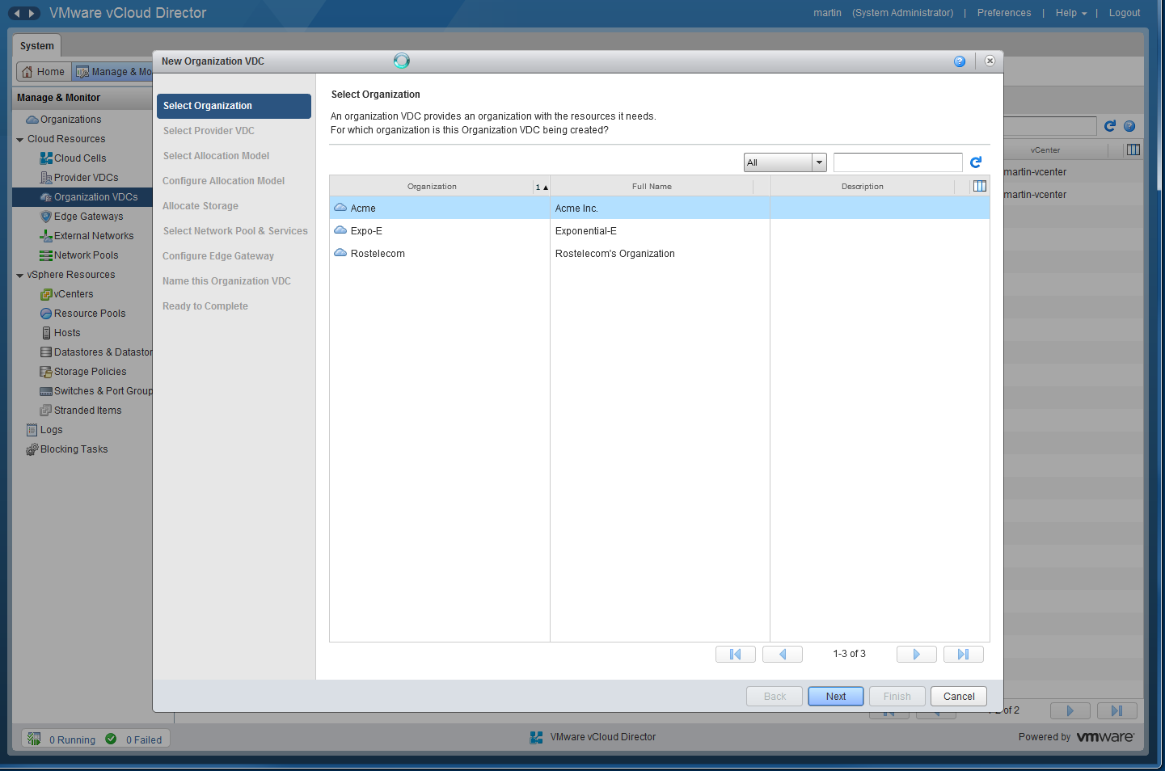
Create an Organization VDC (Cont’d)

Slide 14
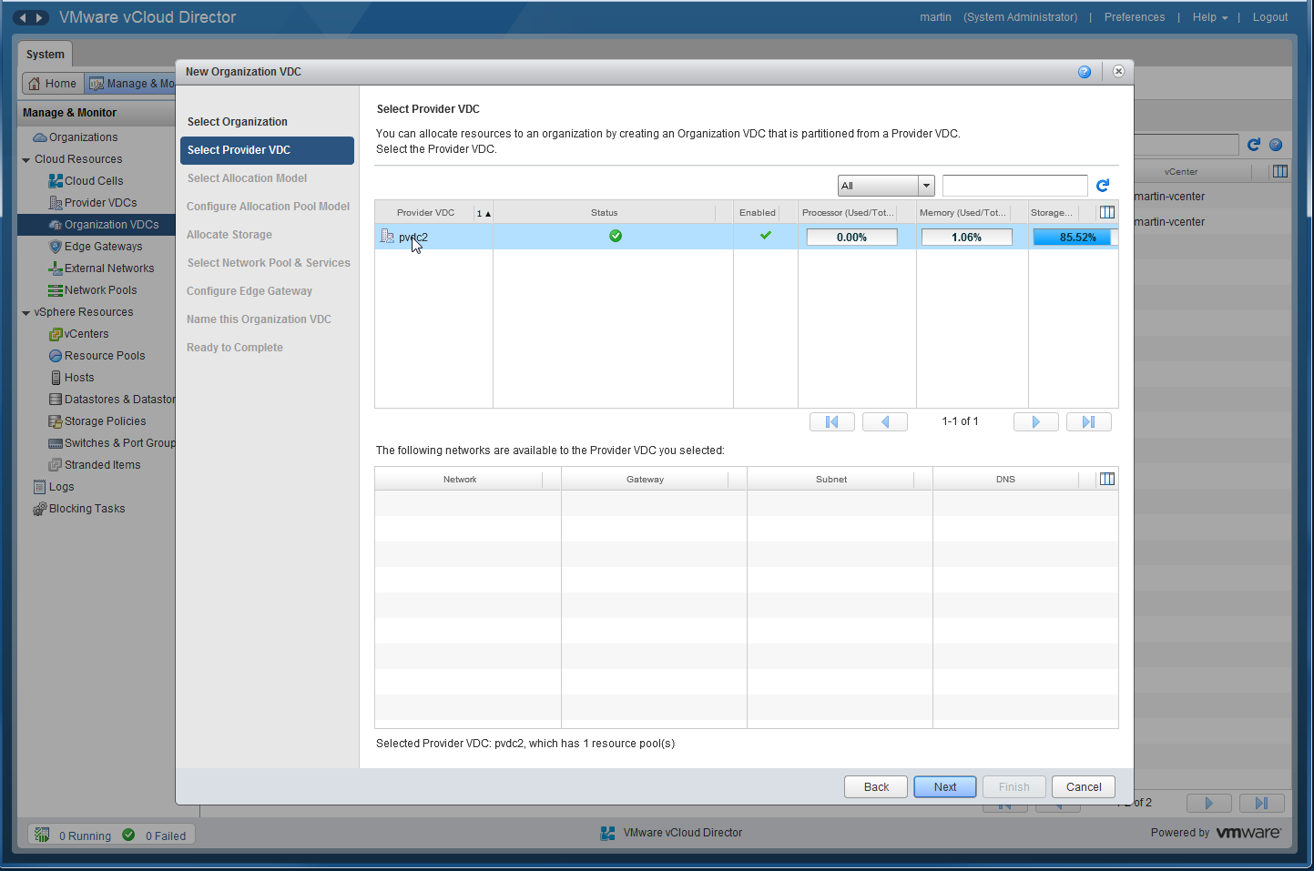
Create an Organization VDC (Cont’d)

Slide 15
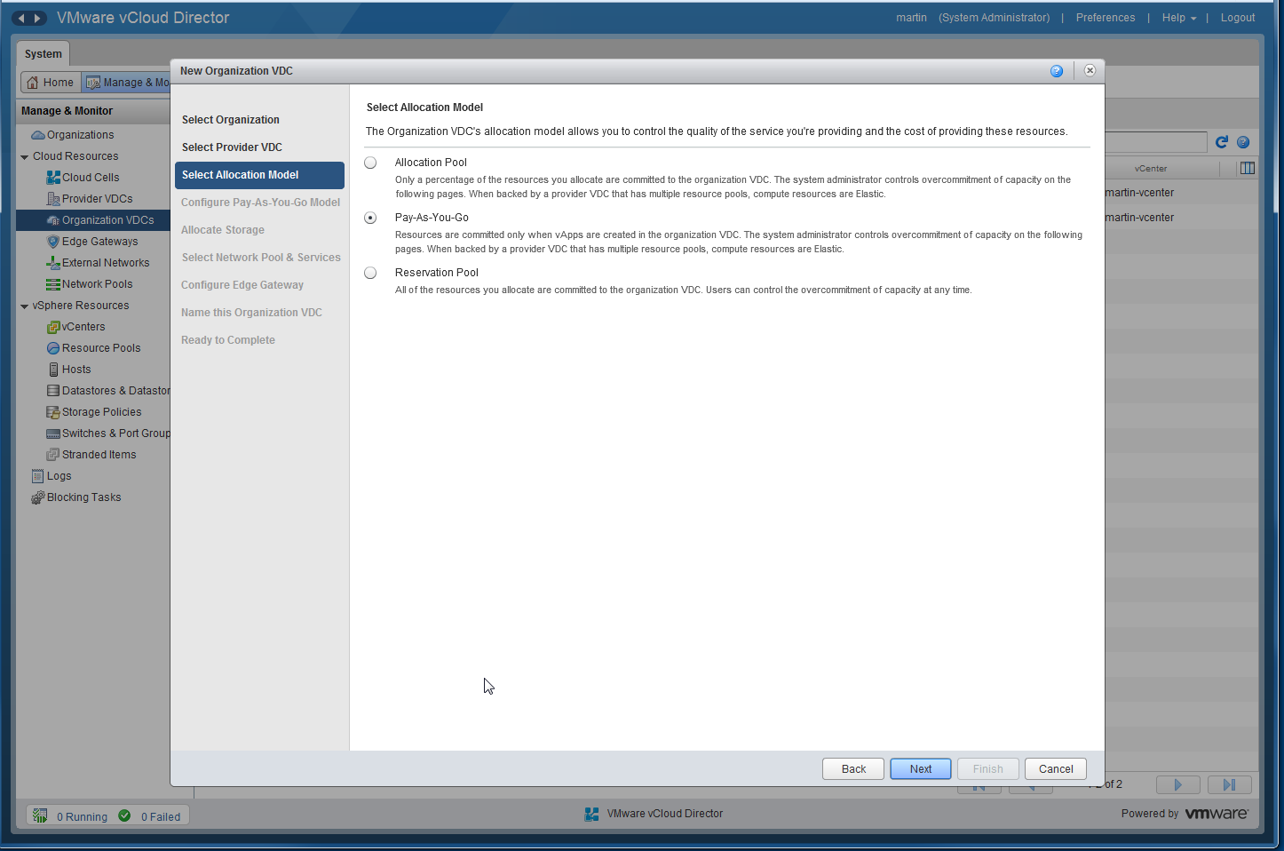
Create an Organization VDC (Cont’d)

Slide 16
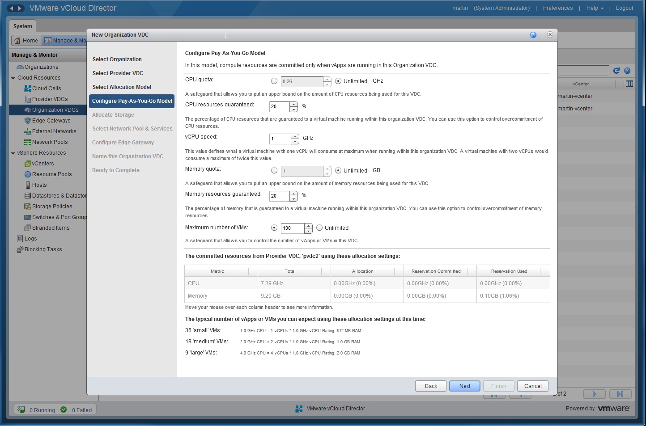
Create an Organization VDC (Cont’d)

Slide 17
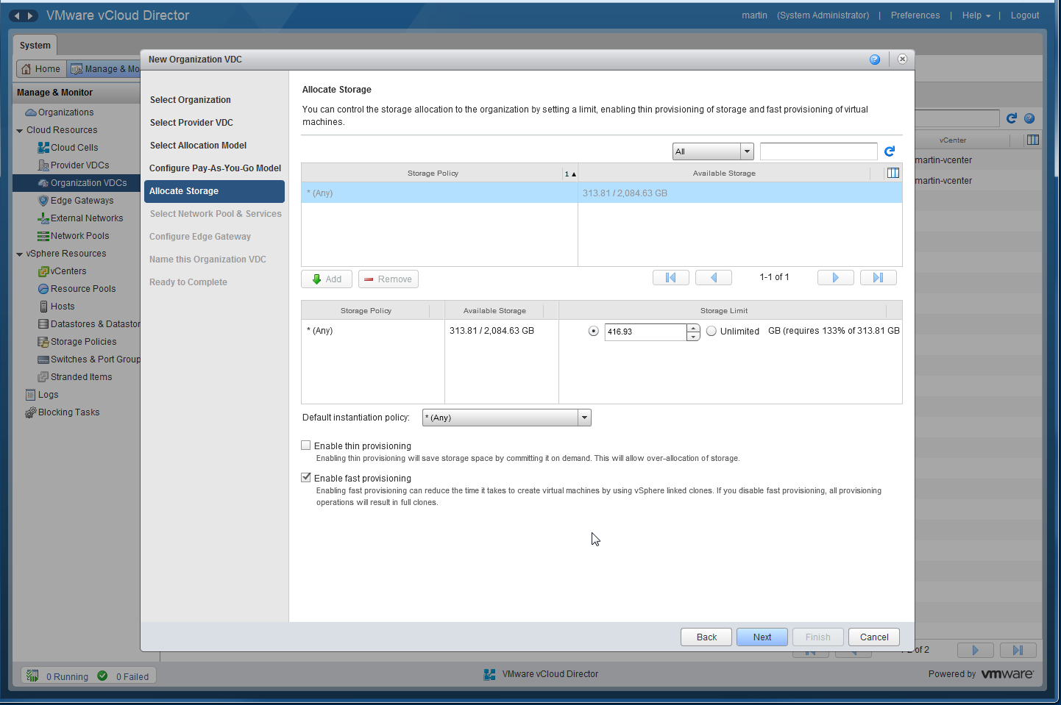
Create an Organization VDC (Cont’d)

Slide 18
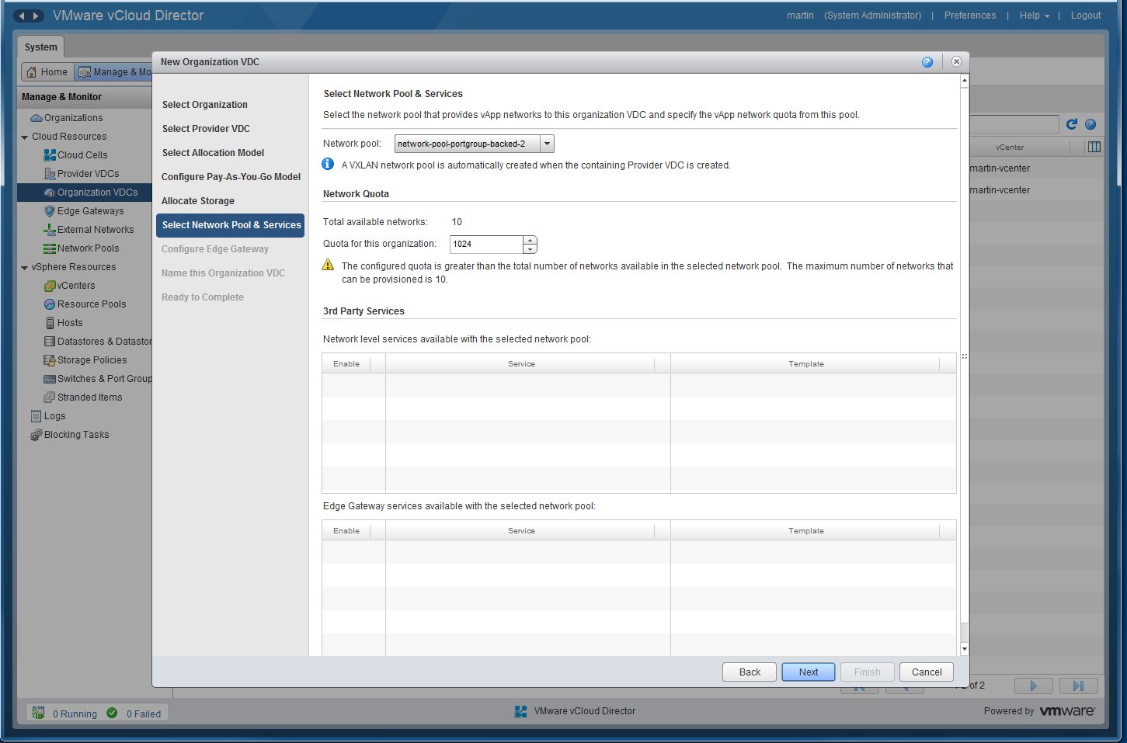
Create an Organization VDC (Cont’d)

Slide 19
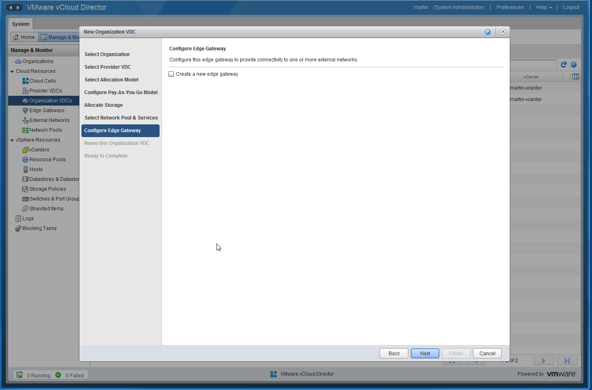
Create an Organization VDC (Cont’d)

Slide 20
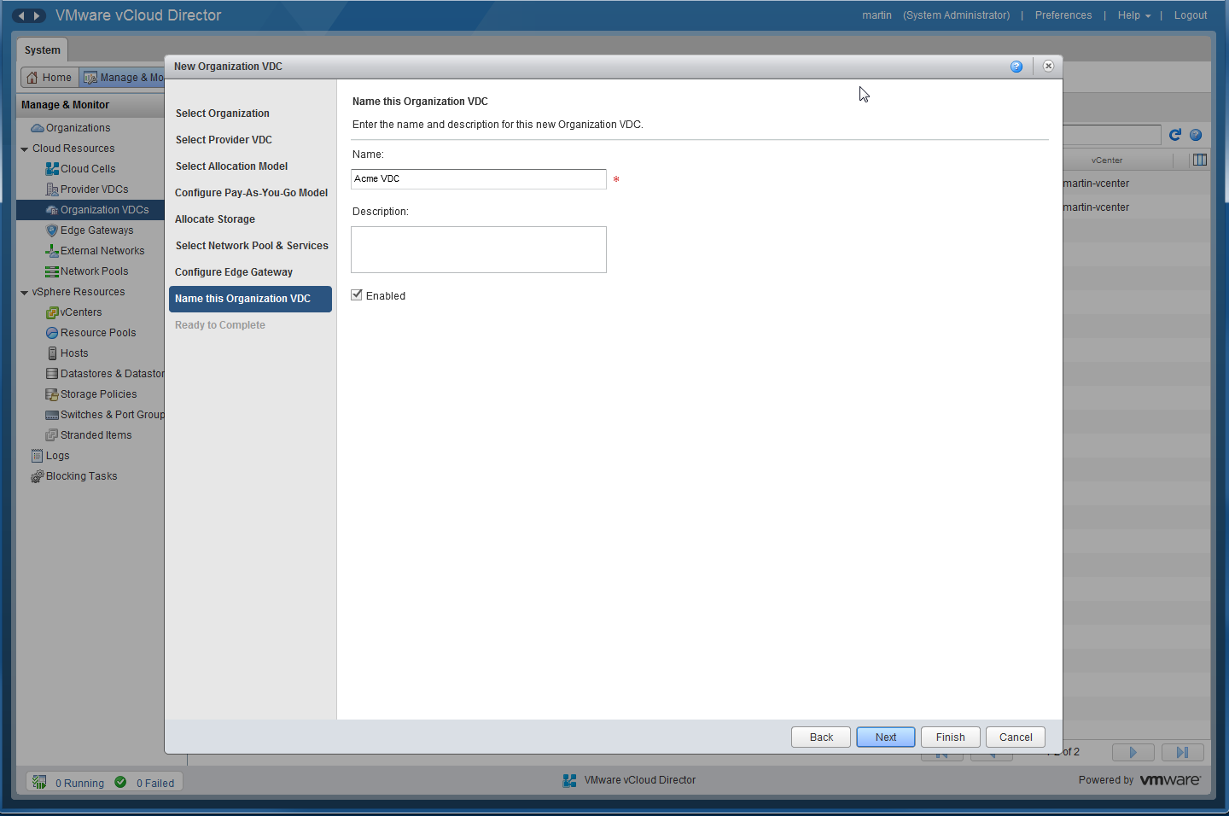
Create an Organization VDC (Cont’d)

Slide 21
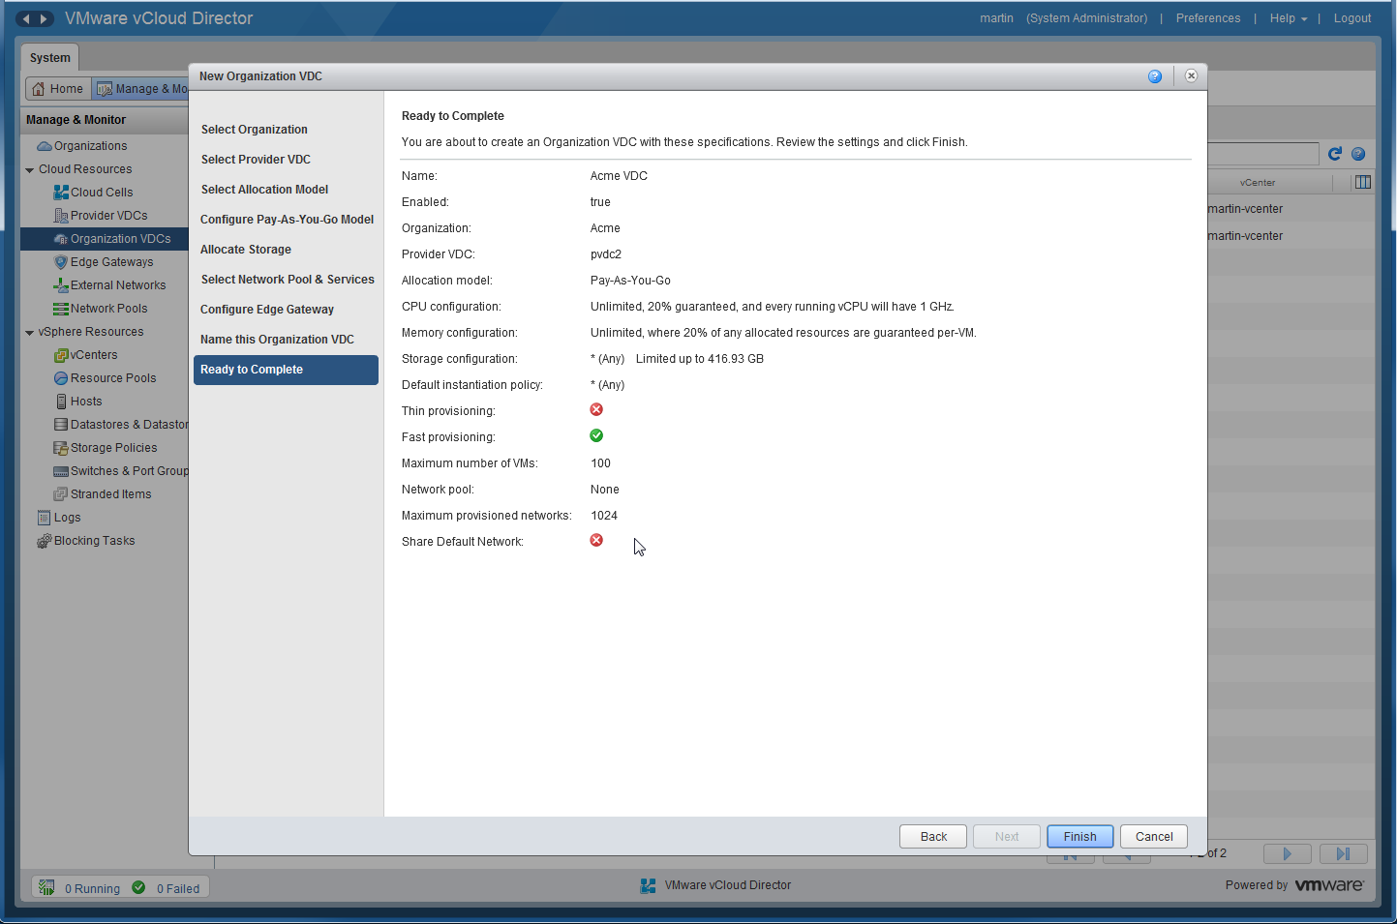
Create an Organization VDC (Cont’d)

Slide 22
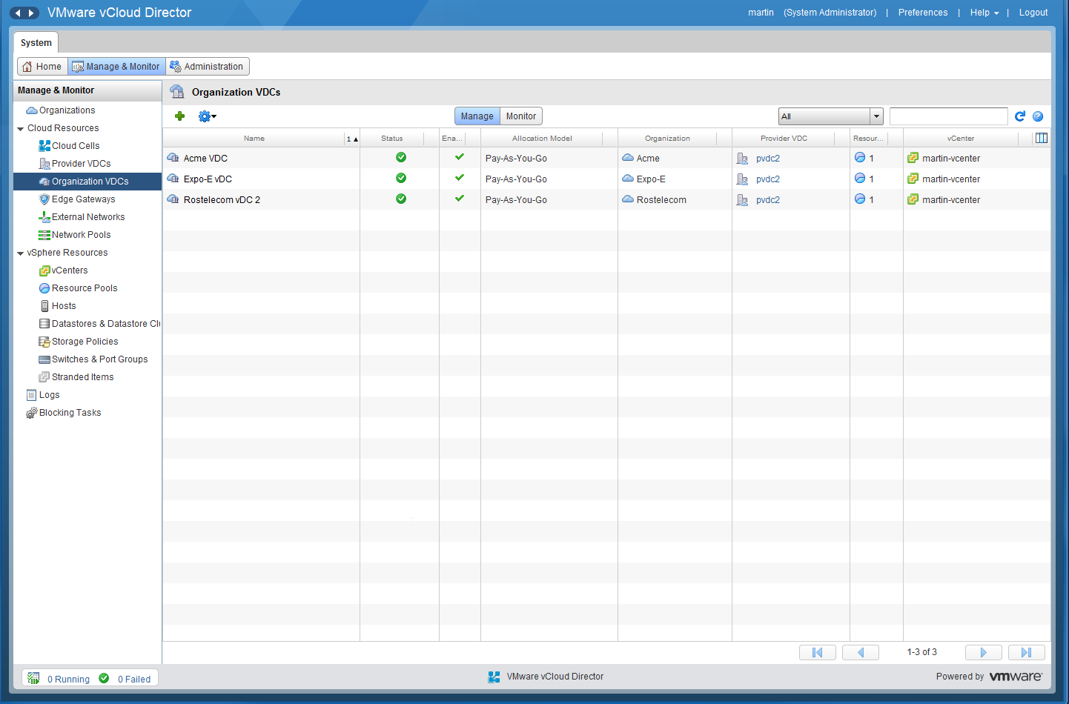
Create an Organization VDC (Cont’d)

Slide 23
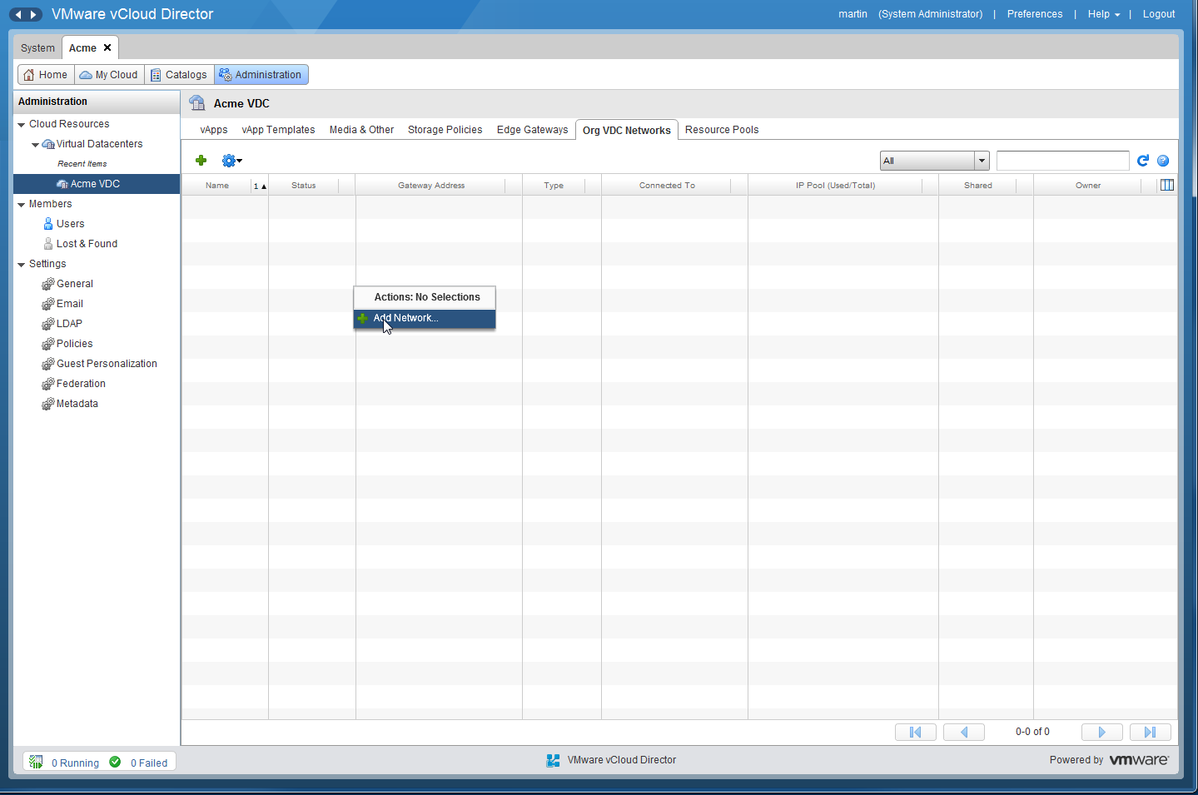
Create an Isolated Org VDC Network

Slide 24
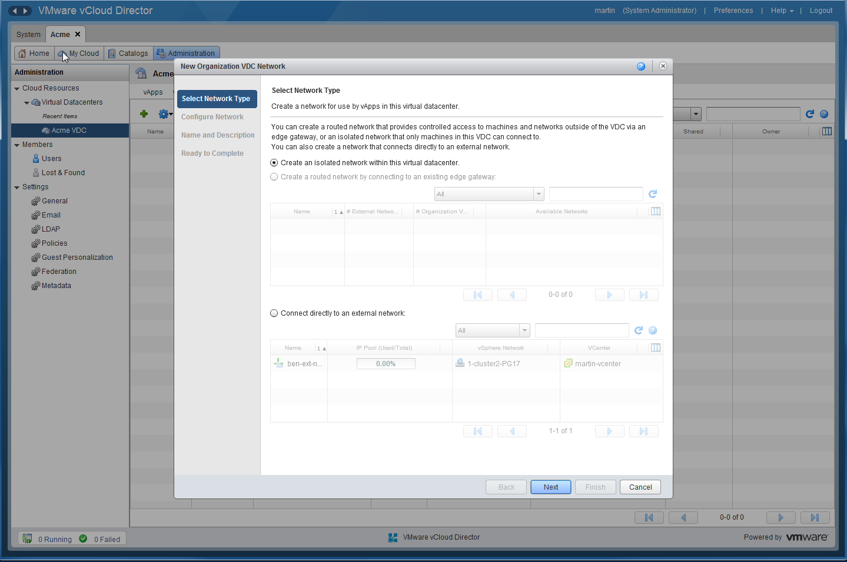
Create an Isolated Org VDC Network

Slide 25
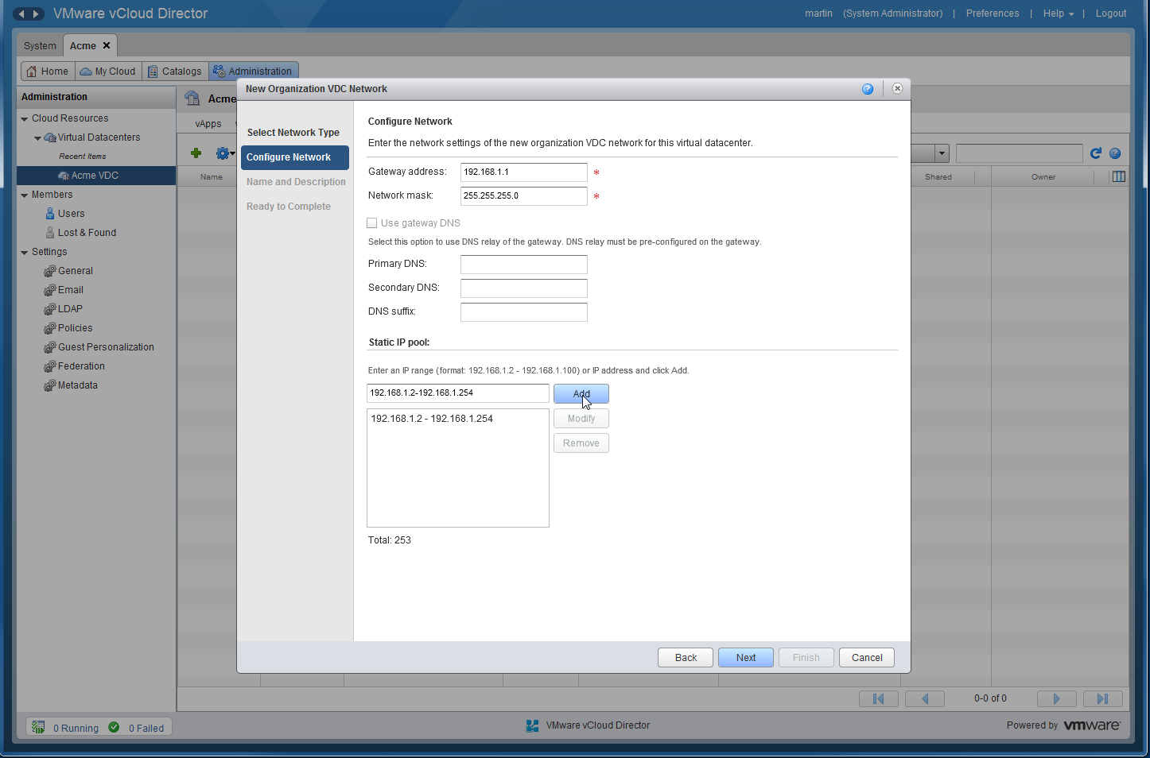
Create an Isolated Org VDC Network (Cont’d)

Slide 26
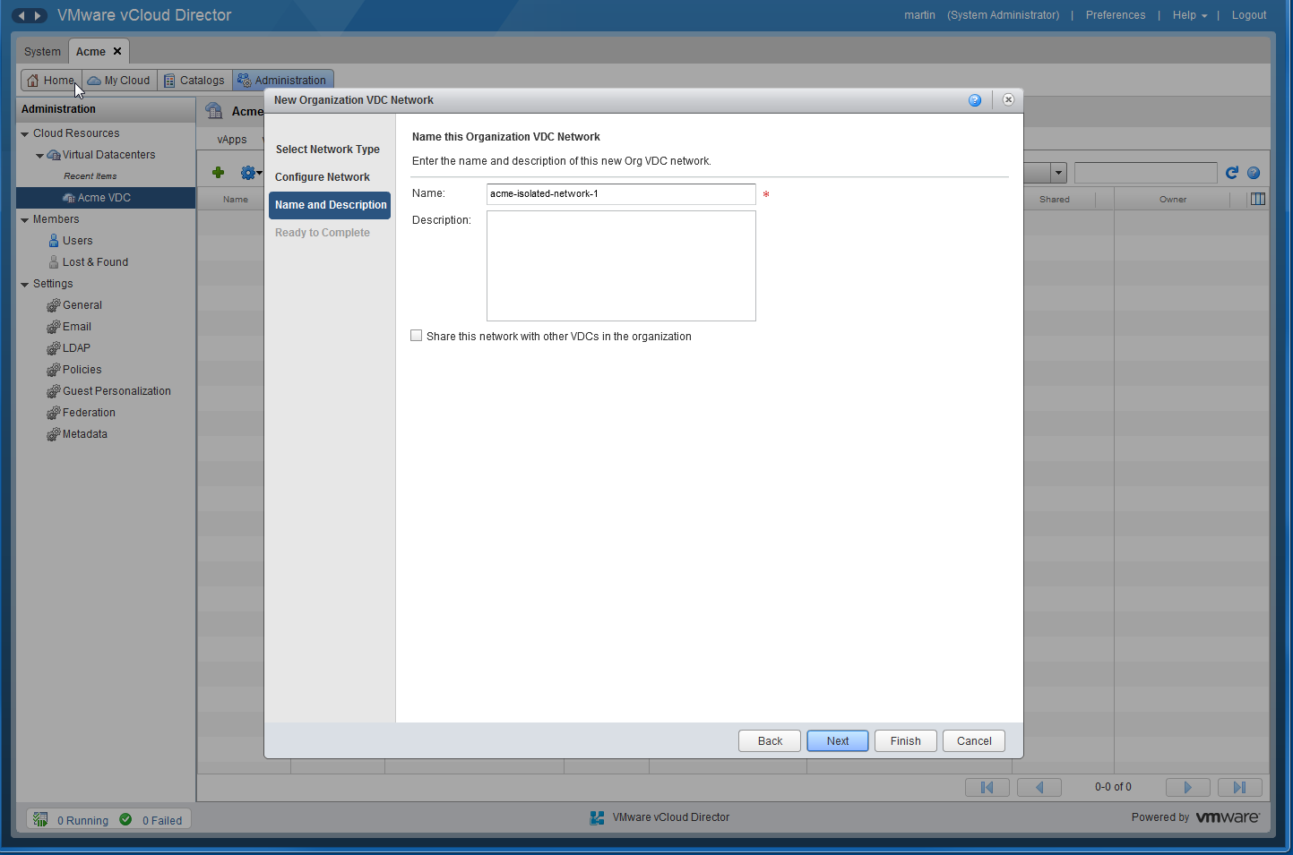
Create an Isolated Org VDC Network (Cont’d)

Slide 27
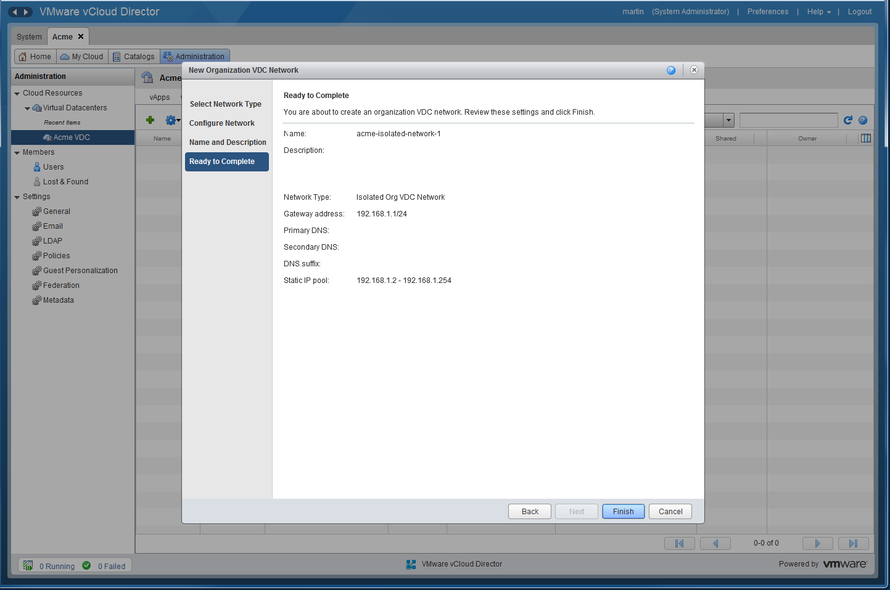
Create an Isolated Org VDC Network (Cont’d)

Slide 28
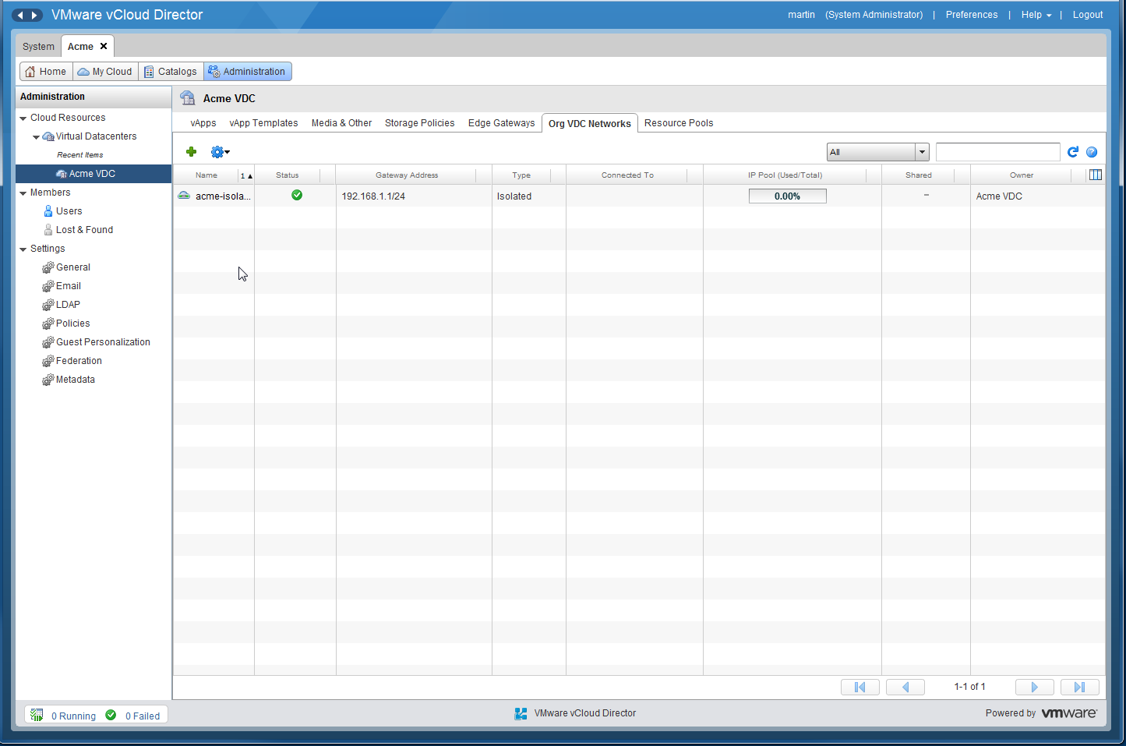
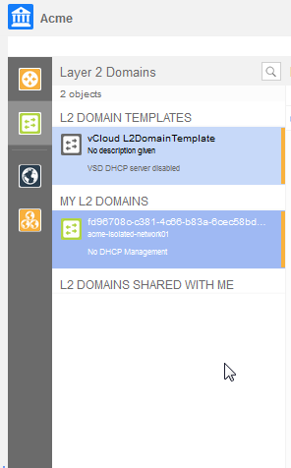
Create an Isolated Org VDC Network (Cont’d)

Slide 29
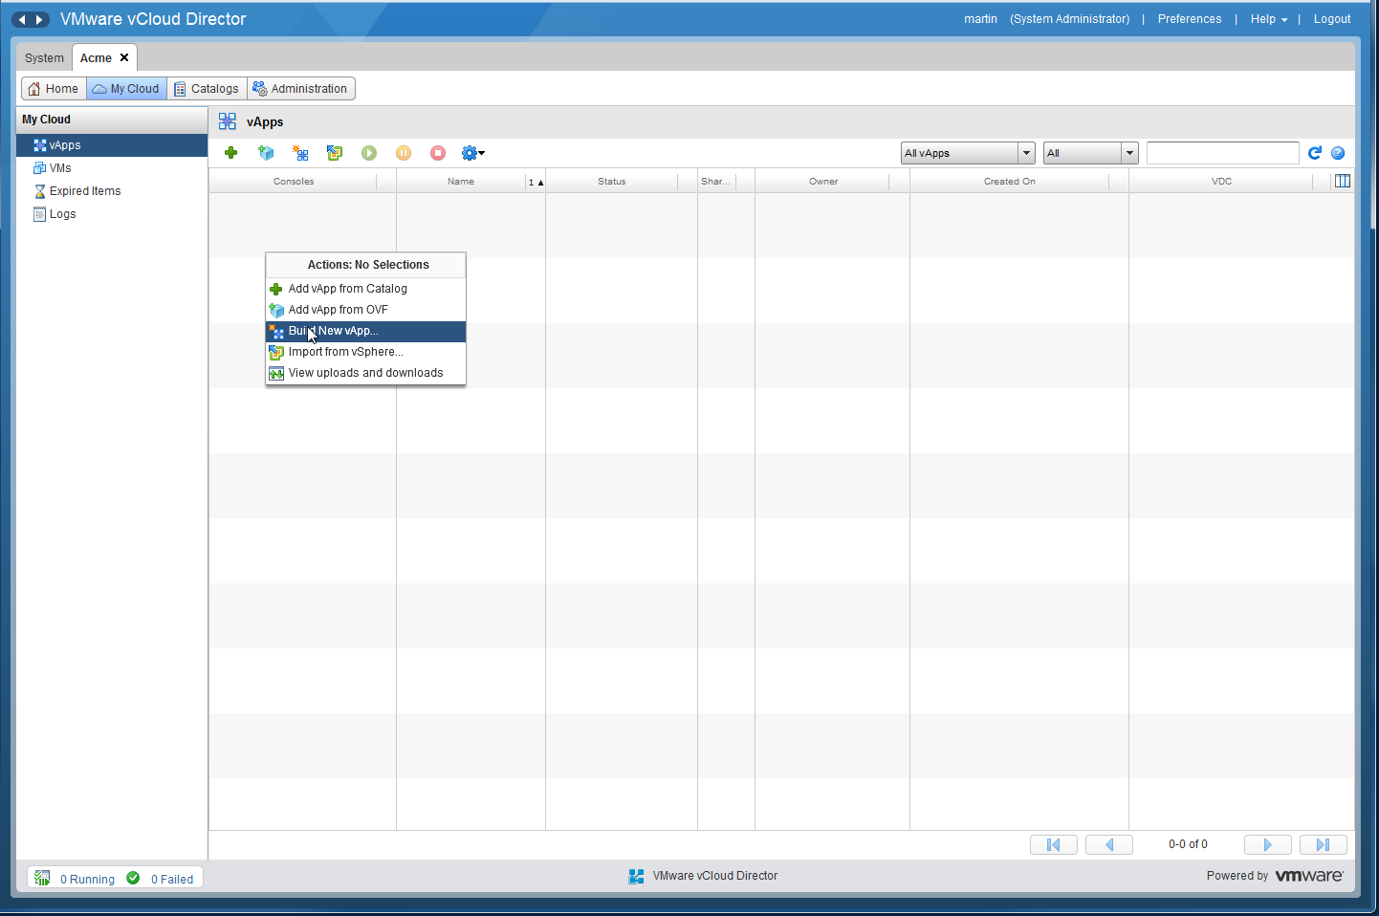
Create a vApp

Slide 30
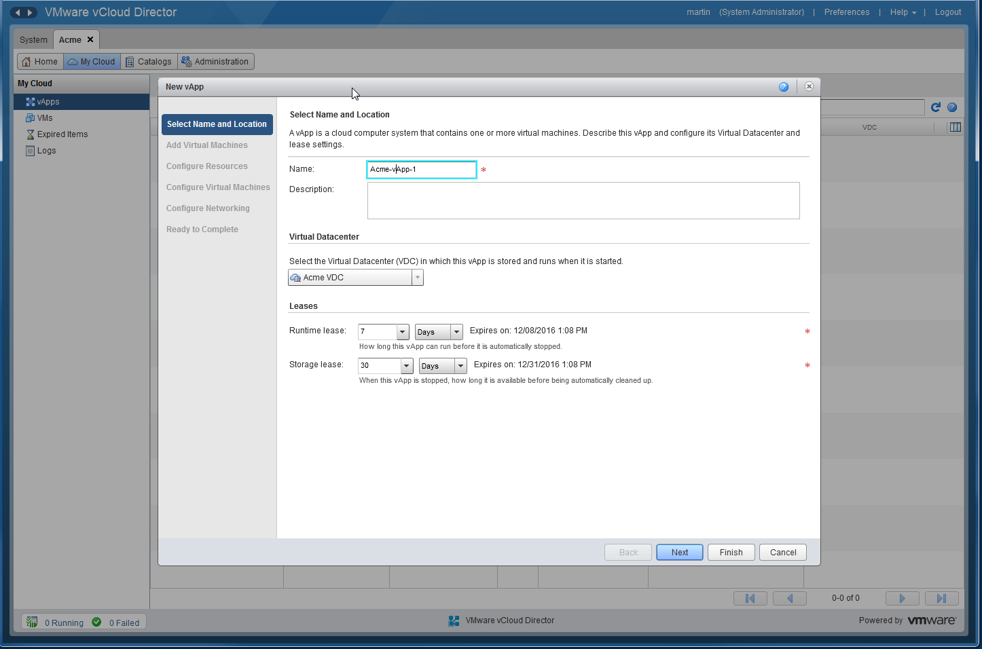
Create a vApp (Cont’d)

Slide 31
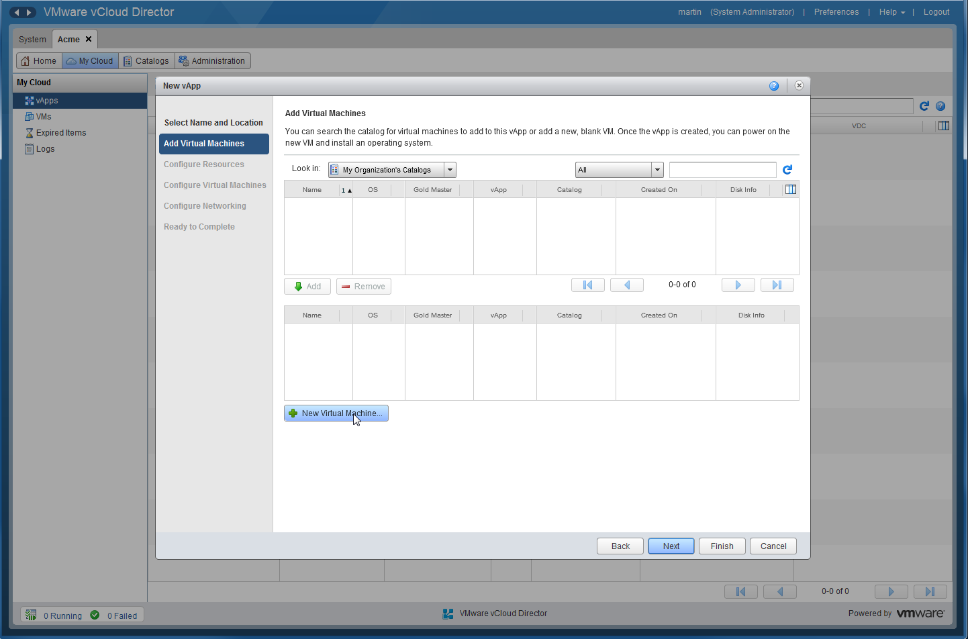
Create a vApp (Cont’d)

Slide 32
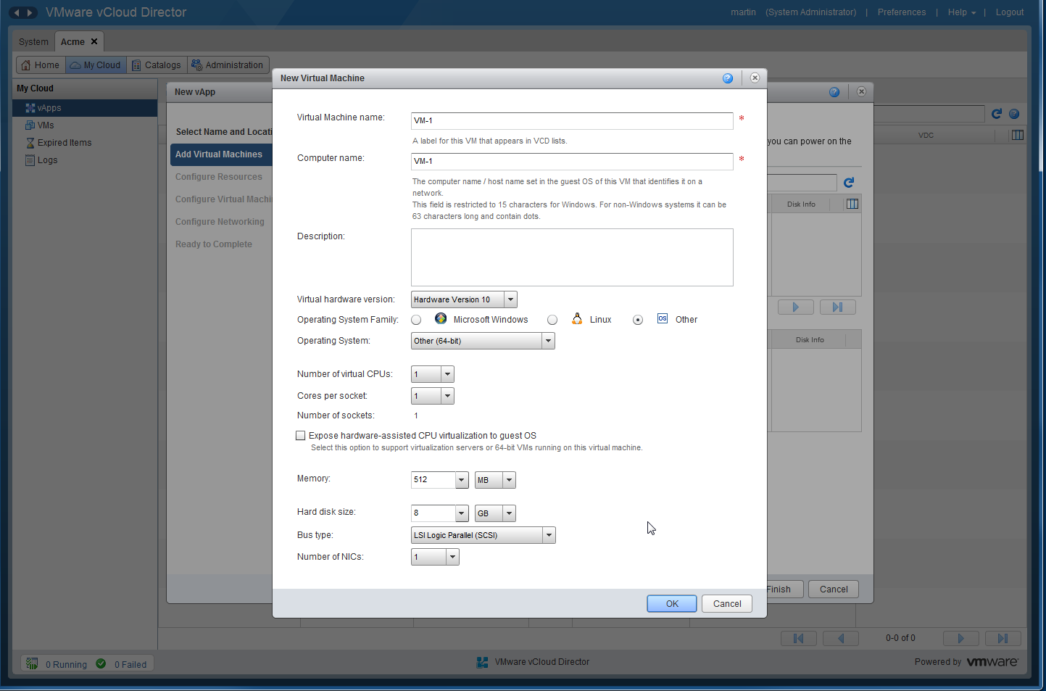
Create a vApp (Cont’d)

Slide 33
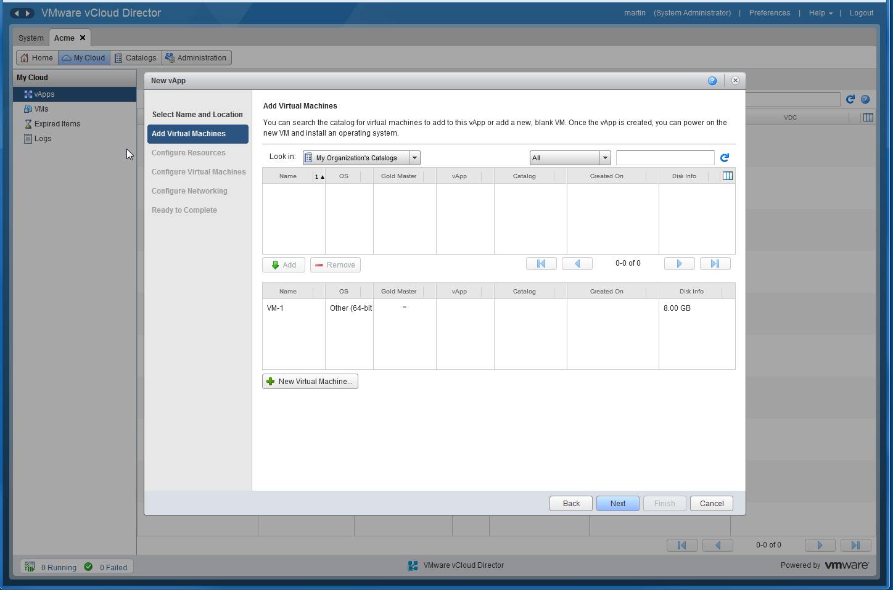
Create a vApp (Cont’d)

Slide 34
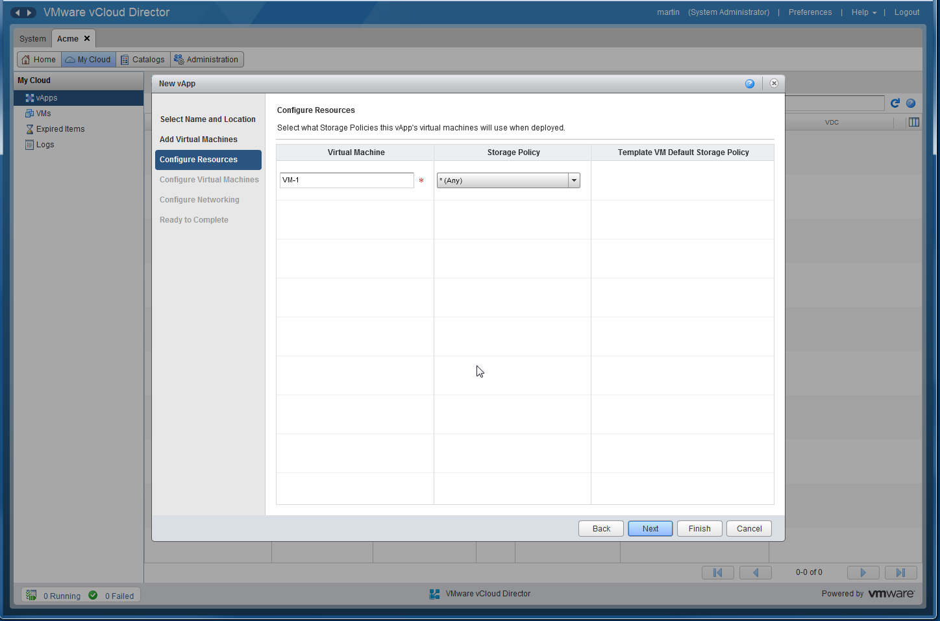
Create a vApp (Cont’d)

Slide 35
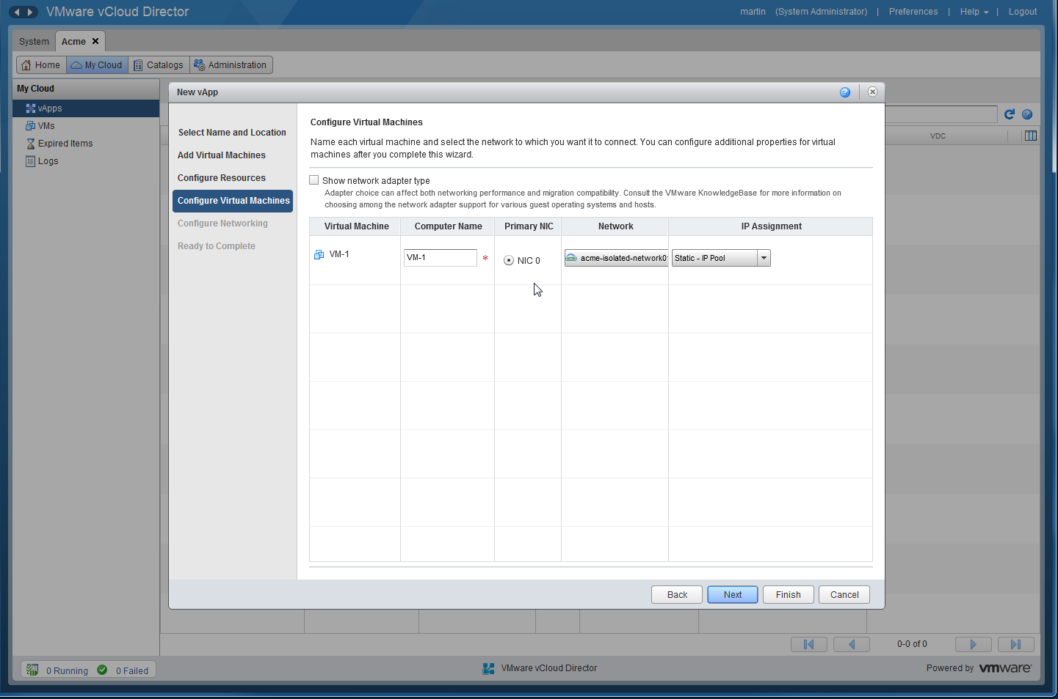
Create a vApp (Cont’d)

Slide 36
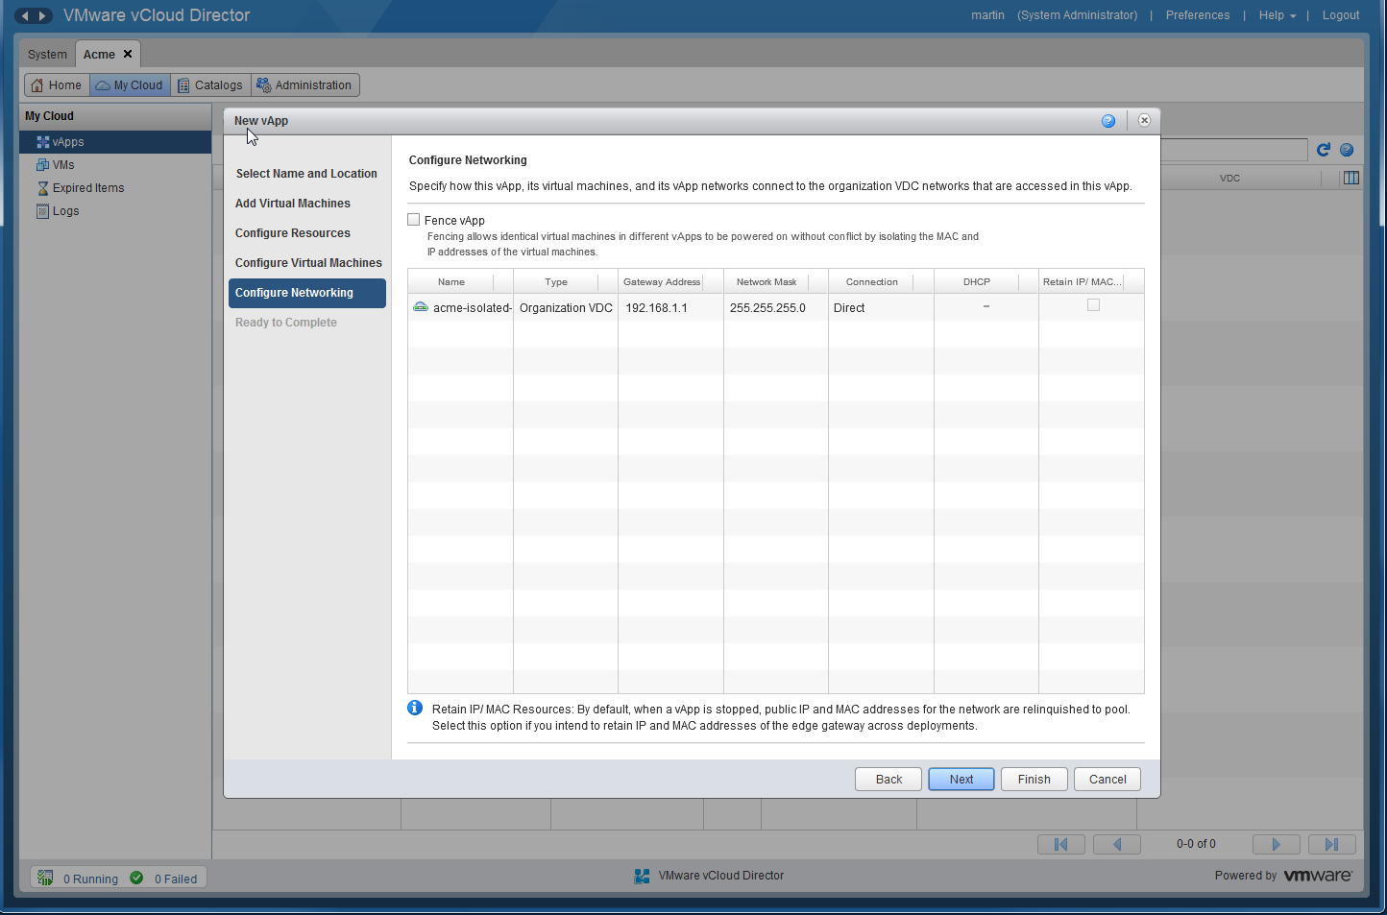
Create a vApp (Cont’d)

Slide 37
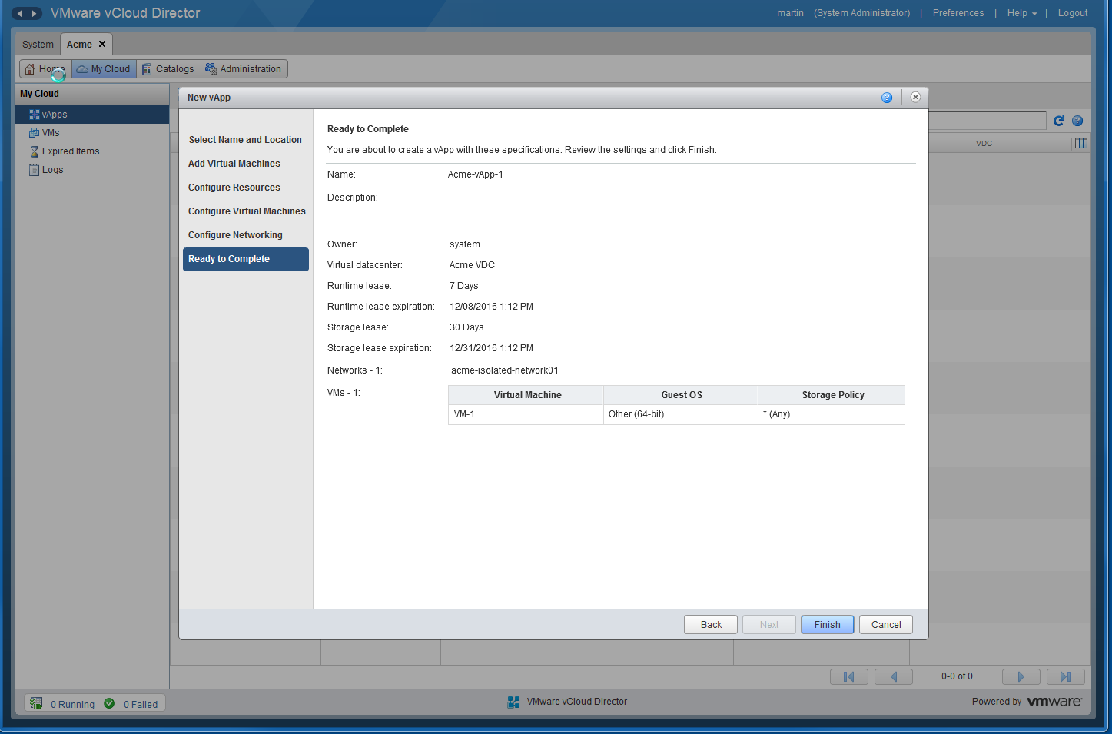
Create a vApp (Cont’d)

Slide 38
Create a vApp (Cont’d)

Slide 39
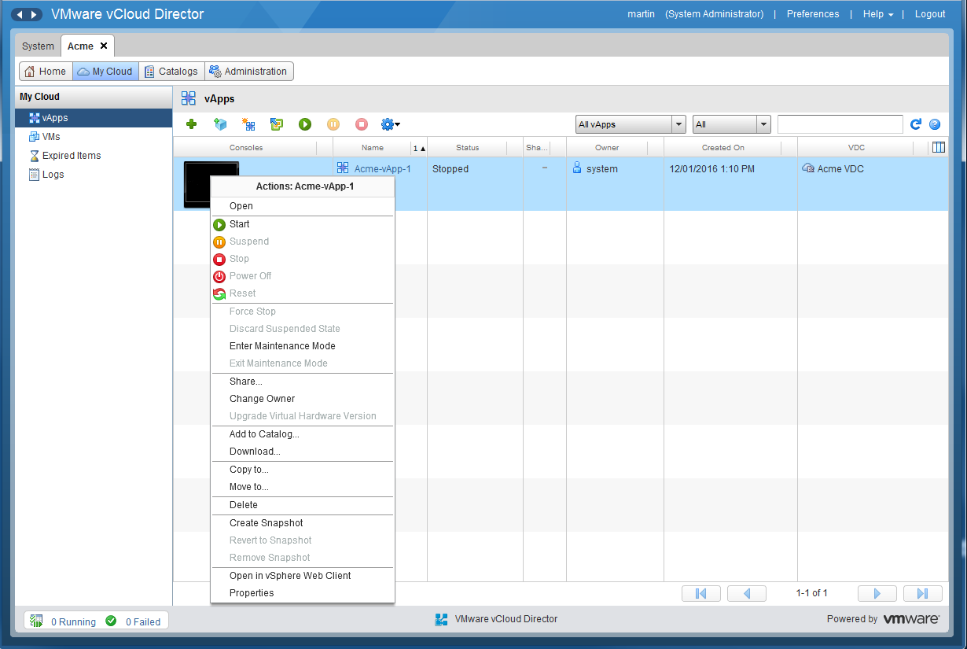
Create a vApp (Cont’d)

Slide 40
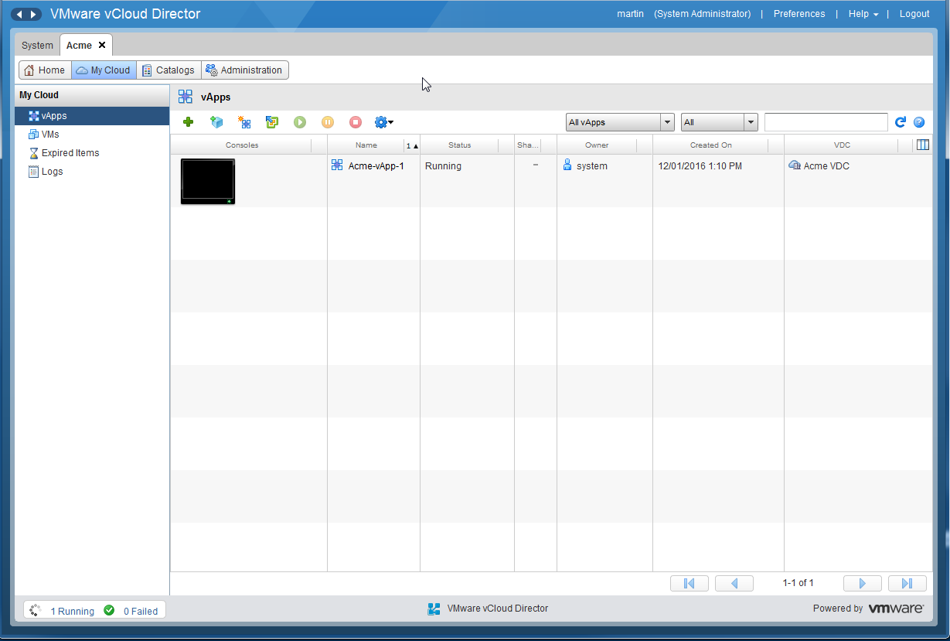
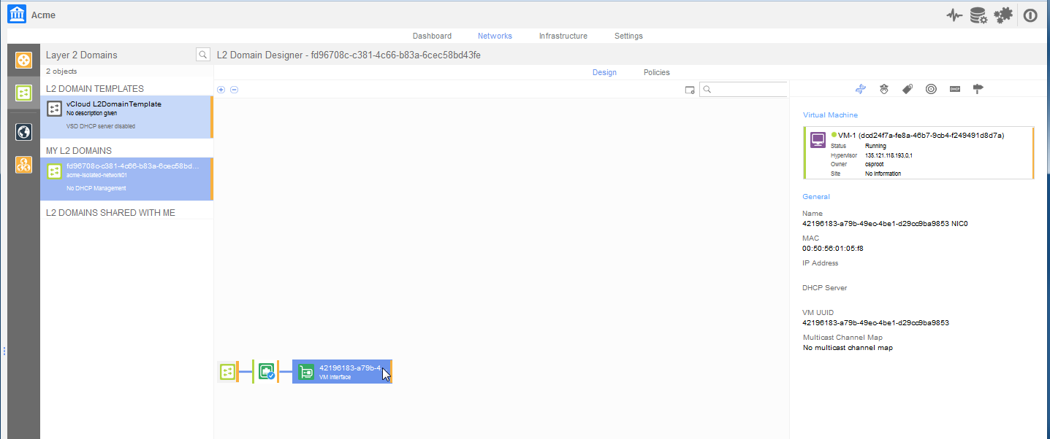
Create a vApp (Cont’d)

Slide 41
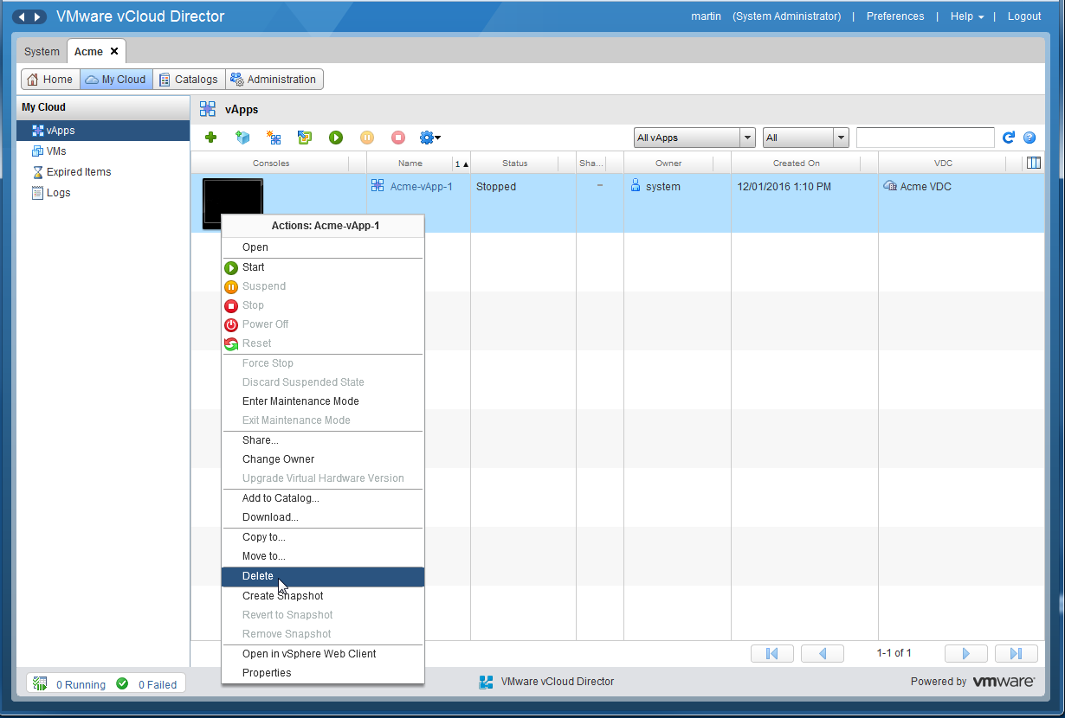
Delete a vApp

Slide 42
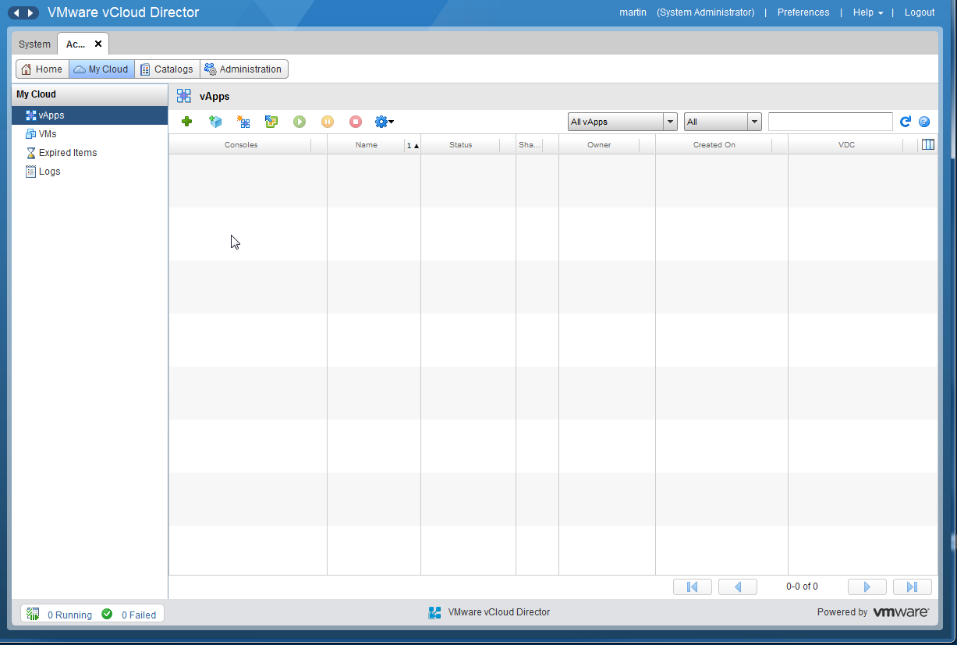
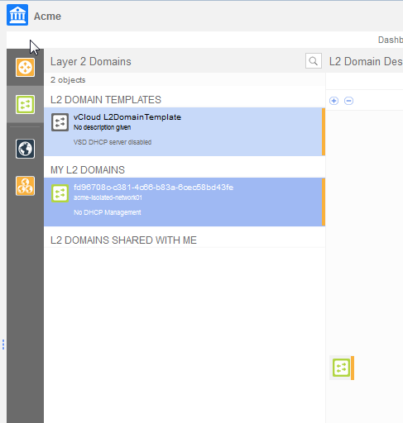
Delete a vApp (Cont’d)

Slide 43
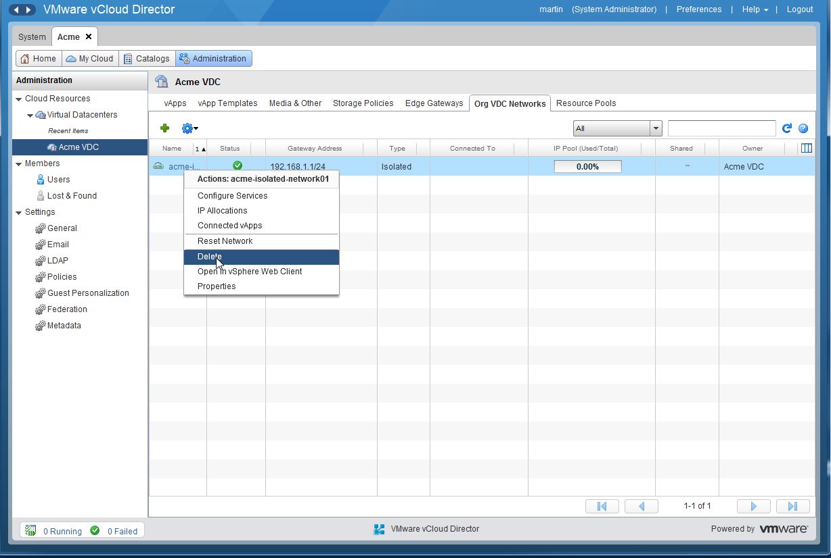
Delete an Isolated VDC Org Network

Slide 44
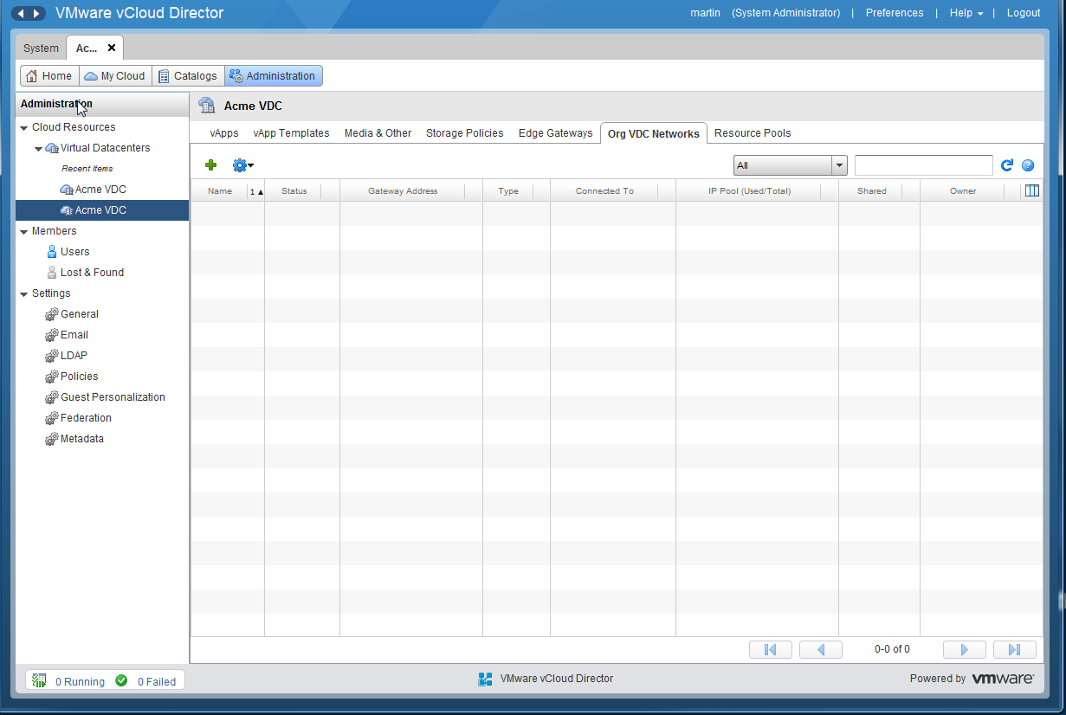
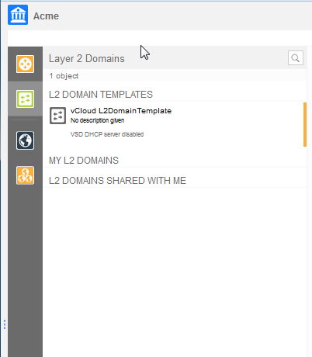
Delete an Isolated VDC Org Network (Cont’d)

Slide 45
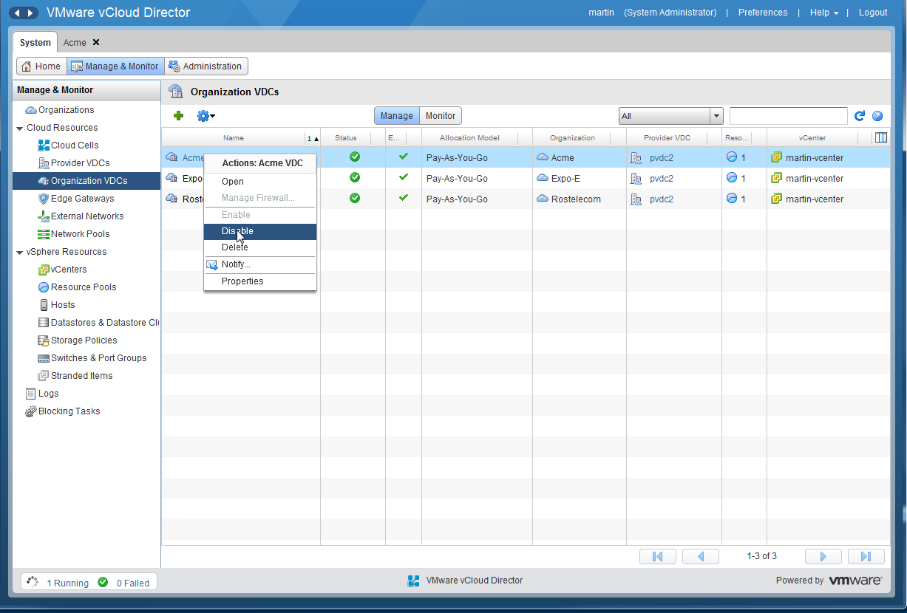
Delete an Organization VDC

Slide 46
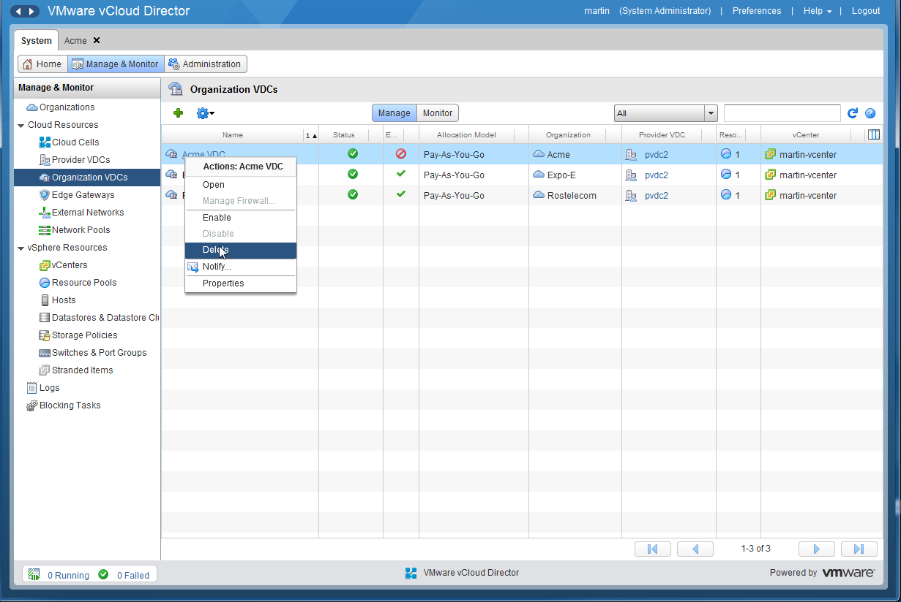
Delete an Organization VDC (Cont’d)

Slide 47
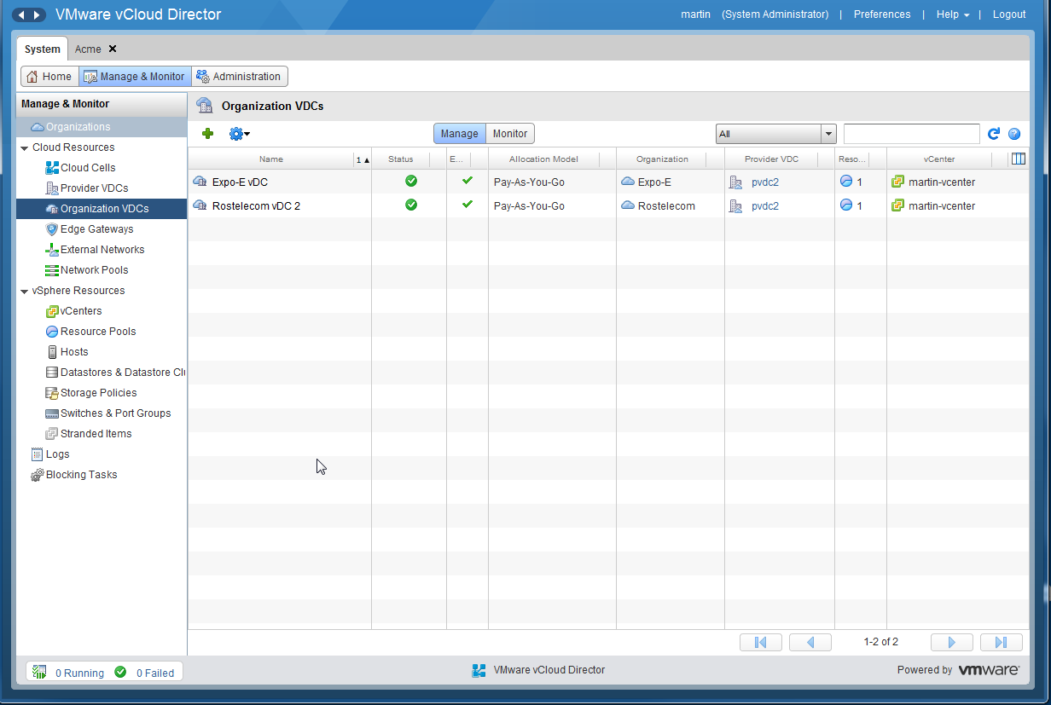
Delete an Organization VDC (Cont’d)

Slide 48
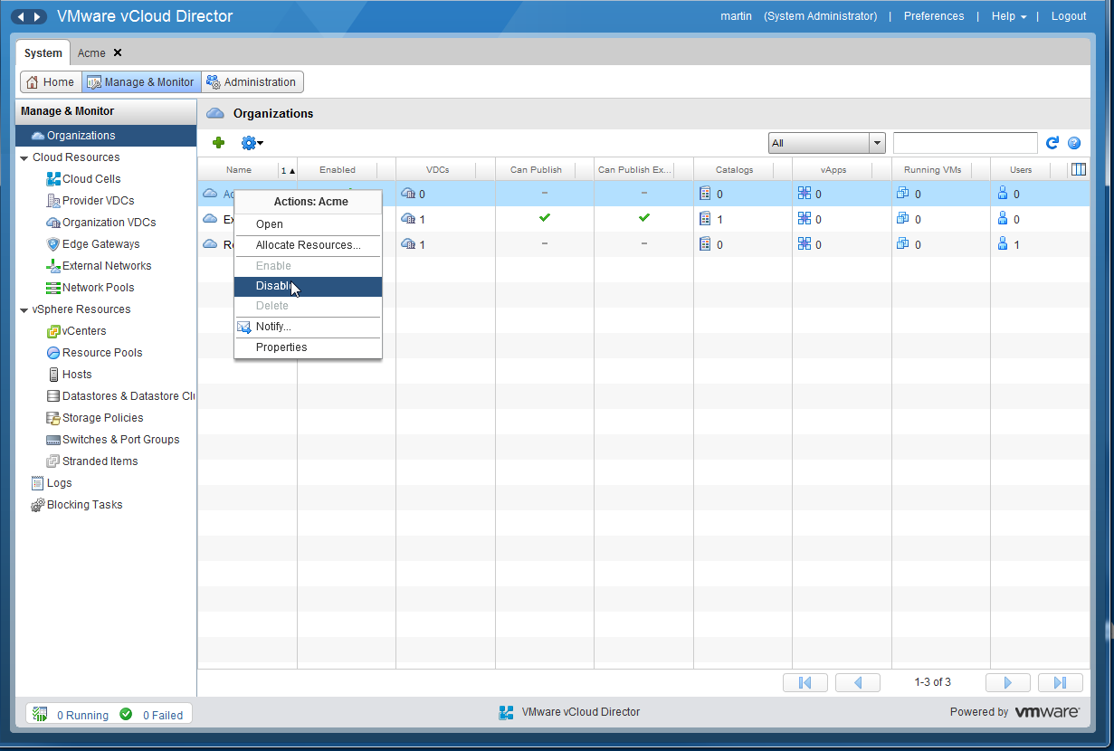
Delete an Organization

Slide 49

Delete an Organization (Cont’d)

Slide 50


Delete an Organization (Cont’d)

Slide 51
Thank you

